Slide 1
Stage properties
Module 5 – Casting

Slide 2
Purpose of making a cast
The original item is too expensive to replace
The original item is too fragile to continually repair
Also could be made of a temporary material (clay or foam)
You only have one original and need more than one
You need to make backup items to have on hand
You need to change the material makeup but maintain form
Have a hard object but need it to be soft (think like a rubber knife)

Slide 3
Types of molds
1-part molds are useful for casting flat or thin objects like knives and coins
2-part molds are more useful for when you have multiple detailed sides and overhangs
A brush-on (glove mold) is useful when you have many organic details and don’t have a good place for a mold break line
All the molds are based around using silicone rubber to surround the original object

Slide 4
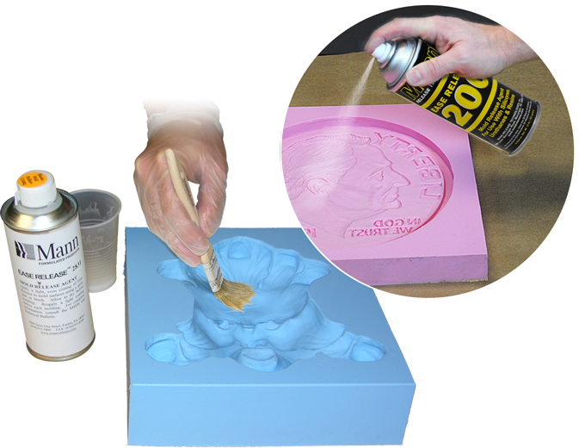
Mold release
Mold release is a coating that prevents any of the mold making material to stick to the original item. There as specialty sprays but can also be as simple as applying a thin coat of petroleum jelly.
Mold release is critical, without it the item you are trying to cast could be ruined, or at least require much time cleaning casting coatings off.

Slide 5
1-part molds are formed in one of two ways
One sided
Sliced removal

Slide 6
2-part mold
One half od the mold is cast around the object
Registration keys are included
(these are the dimples in the picture)
Once dry, the first part of the mold and the object are re-coted in mold release. The object is then covered to make the second half of the mold.

Slide 7
Brush on mold
Brush on molds often will retain the most detail
The brushed-on portion is often very thin 3/8” to 1/2” thick
Usually requires additional mold support

Slide 8
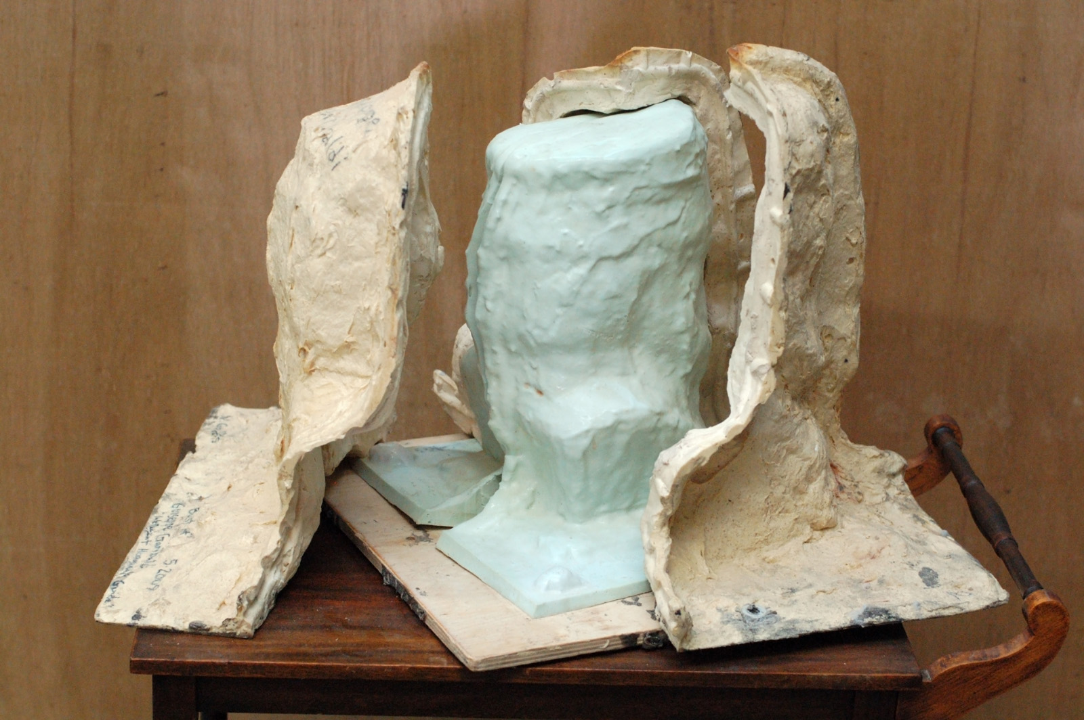
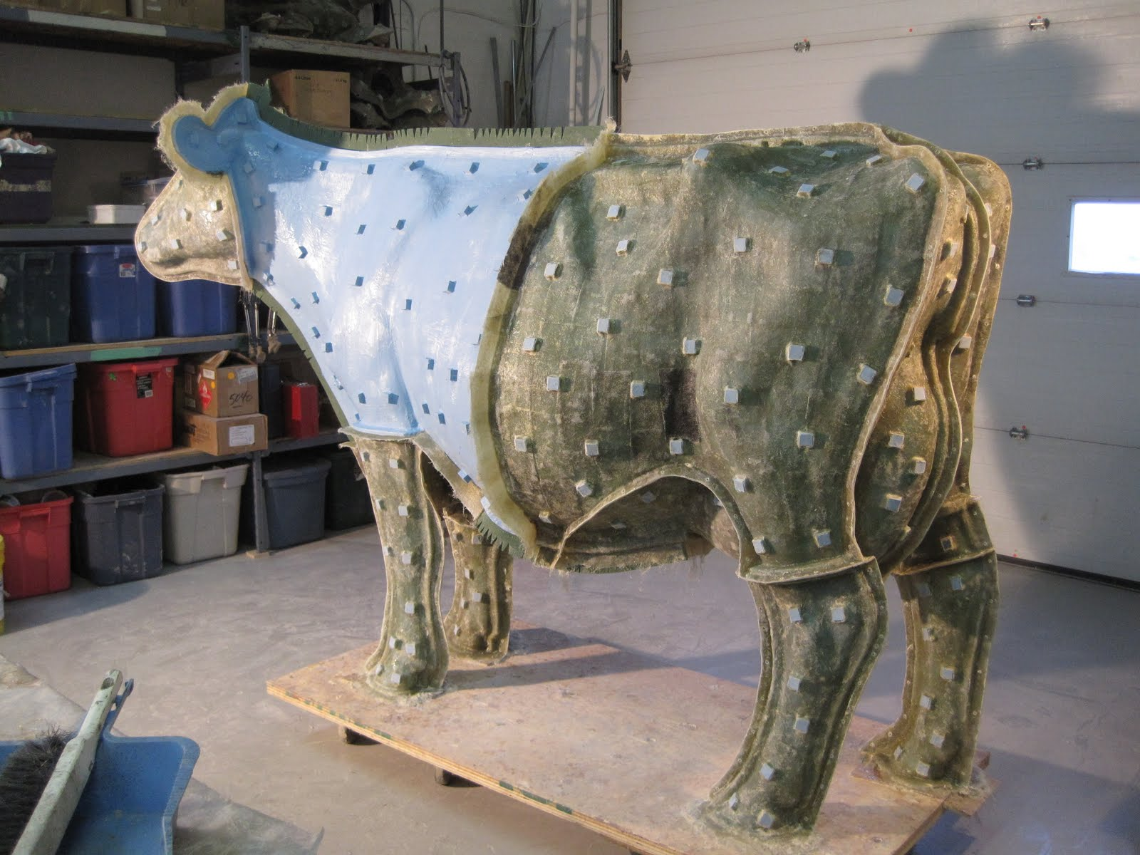
Mother mold
A mother mold is an additional element of the mold that provides structure. It is often made from plaster or fiberglass and back poured around more delicate 2-part and brush-on molds

Slide 9
Flashing
A 2-part mold can have have a thin edge of material where the two halves come together. This thin unwanted portion is called flashing

