Slide 1
Stage properties
Module 4– Sculpting

Slide 2
Additive vs Subtractive sculpting
Additive
Subtractive
The ability to add pieces and portions to your work as you go about the process
Usually found in soft materials that can be speared and pinched to shape
Ex. Clays and putties
Starting with a block of material larger than the desired end size, you remove material
First rough out shape with coarse tools
Work up to tools that make fine adjustments (sandpaper or polish)
Ex. Woods, stone, foamboard

Slide 3
Types of foam
It is important to know what type of foam you are working with in order to what modifying techniques are safe and what substances won’t alter the surface

Slide 4
Expanded Polystyrene (EPS)
Comes in many thicknesses
Readily available
Made from little round pellets of foam stuck together
This can be a challenge to get smooth
Dents and snaps under force
Acetone, and some paints and glues dissolve this foam
Flammable and responds to heat
Safe to cut with a hotwire
Also called bead-board

Slide 5
Extruded Polystyrene (XPS)
Comes in many thicknesses
Readily available
Solid foam sheet semi-dense
Sands easily with drywall screens
Dents and snaps under force
Acetone, and some paints and glues dissolve this foam
Flammable and responds to heat
Also called Pink-foam or Blue-foam

Slide 6
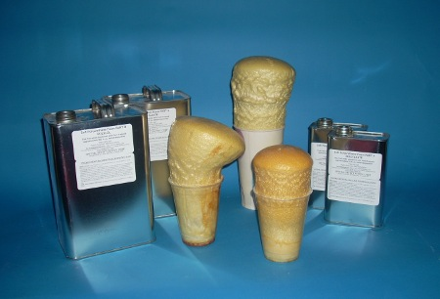
Urethane Foam
Comes in sheets, cans, and 2-part liquid
Comes in various densities
Can be sanded but take precautions
Gloves, mask and ventilation
Solvents have little effect on cured urethane foam
Flammable and responds to heat
TOXIC!!!
Do NOT use hotwire

Slide 7
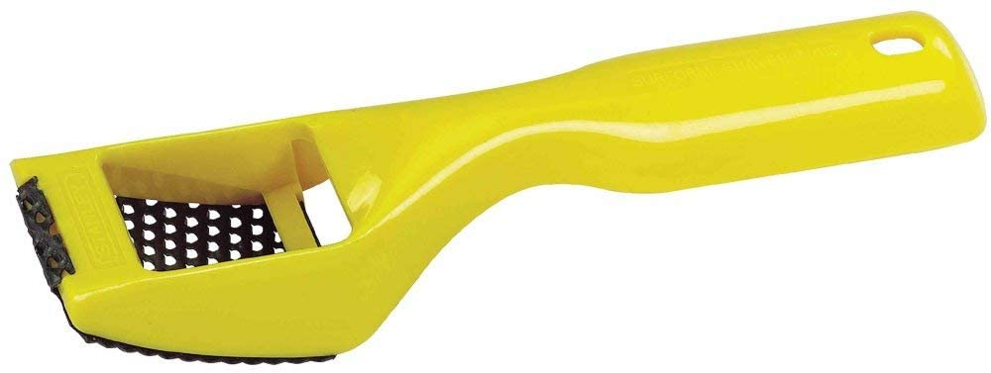
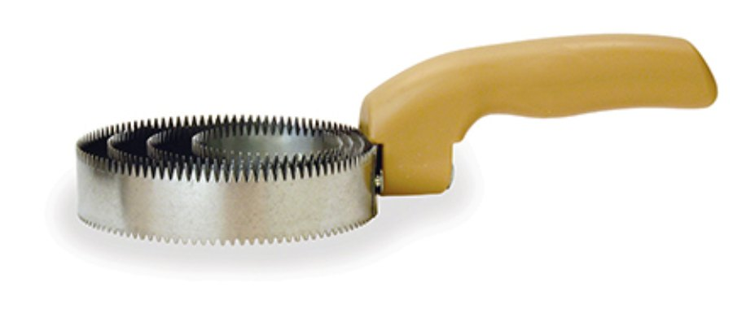
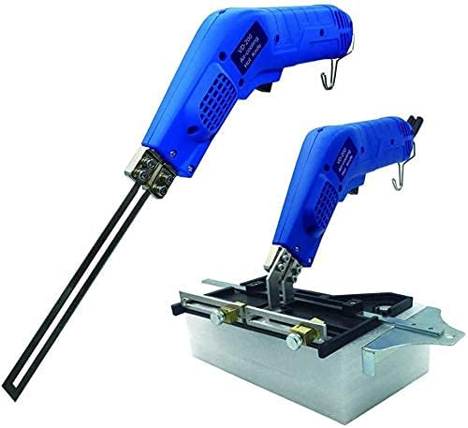
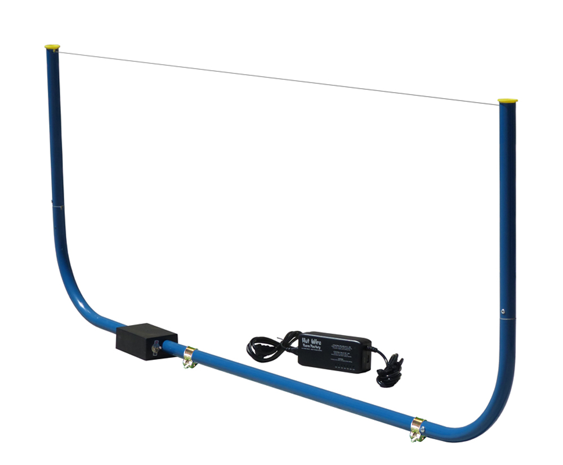
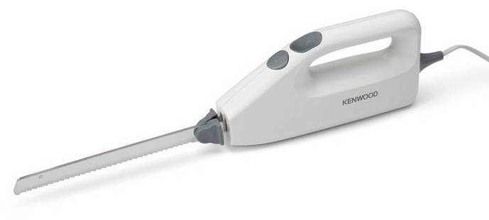
Tools for foam
Foam shaver
Wood rasp
Curry comb
Hot knife
Hotwire
Retractable box knives

