Slide 1
Stage properties
Module 3 – Measuring

Slide 2
Very rarely does one just “wing” making a prop
Props are crafted from:
Words from director
Sketches
Pictures
Drafted documents
Originals

Slide 3
Director’s words
Any time you have a chance to talk props with a director, take notes!
Directors often speak of exactly of what. They are picturing – this is helpful for getting to what is wanted.
If the prop isn’t explicitly known, you are often given information on general size/shape and usually color and texture
It never hurts to come prepared with research imagery for talking points

Slide 4
Sketches
Sketches are often the first visual from a props designer’s head
It is a good starting point for discussions with director and props team
Can be useful for taking relative measurements from
You don’t have to be a good drawer as long as your drawing communicates your idea(s)

Slide 5
Pictures
One of the most useful forms of research for props
Often informs of color and texture
Can inform size and scale
Often will inform of original material
We can fake this but it is good to know
Sometime will show proper use
More angles offer more information

Slide 6
Drafted documents
Drafted documents often come from 2 sources
Previously created items available on the internet/for purchase
A designer provided specific drawings to meld with other designs
A props designer can draft their own creations
Useful for creating exactly what they want
Props artisans can build from a drafting

Slide 7
Originals
Be very meticulous with originals
They can be fragile and priceless
Get as many photos as you can
Include something for scale reference
Try to see that lighting is adequate for proper representation of color
If the item is moldable, and you’re allowed, cast a replica

Slide 8
Measuring from a “hand”
If you happen to have a hand in a reference photo, you can get an estimation of the total length of hands long an item is
Then measure your own hand for a numeric length
How long do you think the sword is >
9-10 “hands”? If a hand is 4” wide?

Slide 9
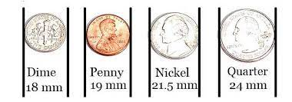
Measuring from a “coin”
If you’re a in a situation where you don’t have anything to measure with, but you can take pictures
Include a coin for size reference
How large do you think the moth is >
1.5 “coins”? If a quarter is ~1” wide?

Slide 10
Using a scale rule
Scale rules are useful when you are provided a draft in scale of something you want to make
If you know the scale that the draft
You can measure undocumented measurements accurately
You can also make enlargements by using alternate scales
1” scale measured at ½” scale is a 2X enlargement

Slide 11
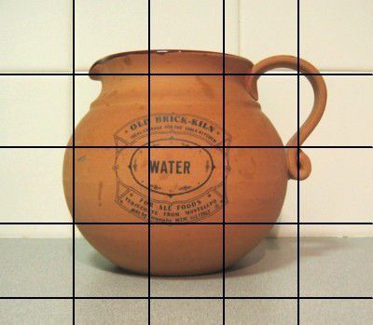
Enlargements
Projector method
Griding

