Slide 1
Stage properties
Module 1 – What is a prop

Slide 2
The types of props
Hand props
Props handled by an actor
A Practical
A prop that operates as you would expect
Dummy props
Non-functioning look-alike
Rehearsal props
Stand-ins for the actors to rehearse with
Show props
Often the more expensive version of a prop, or one that kept in good condition
Costume prop
Items not specifically worn but help define a character

Slide 3
The types of props continued
Consumable props
Items that are eaten or have to break
Running props
Items with a shelf life or wear over time
Batteries and folded paper products
Breakaway props
Items designed to break in a certain way then be reassembled later
Set props
Large movable objects
Furniture
Trim props
Pictures, curtains and blinds
Set dressing*
Additional items/objects that help establish place or time
Actors don’t interact with these

Slide 4
Borrow, rent, buy, or build
Borrowed items don’t cost (maybe a deposit)
Items from community theaters and community members as well as other institutions
Usually can’t alter
Rented items often cheaper then to buy
Don’t have to store after show
Usually can’t alter
Bought items can be expensive
Often can be altered to your needs
Multiples can be purchased
Replacements can be acquired if needed in the future
Built items
Made to the exact specifications needed for a show
Can be sturdier or more easily repaired than bought items

Slide 5
Who does what in OUR theater
Props designer
Responsible for sourcing or designing the props/furniture to be built
Often in communication with scenic designer and director
Props manager
Maintains props and assists with construction of props
Manages additional props artisans
Props runner
Responsible for setting out and collecting props for the run of a show
This responsibility may fall on the props manager

Slide 6
Making an effective prop
Understand what the prop needs to do
Stood upon
Dropped
Filled
Worn
Illuminate
Understand what the prop needs to look like
Match the surrounding scenery
Resemble a more expensive material
Appear heavier than it actually is

Slide 7
Evaluating difficult props
Many complex props can be broken down into simple parts
Many items can be assembled to make a complex prop
Start with research and make steps into the build… then reevaluate
Sometimes complex textures can be faked
Sometimes we can paint texture so the prop doesn’t need physical texture
In the end, a successful prop is one that does what it needs to do and holds up through a production

Slide 8
Evaluating your resources
Money
Time
Experience
These are the things that need to be considered when budgeting a prop build

Slide 9
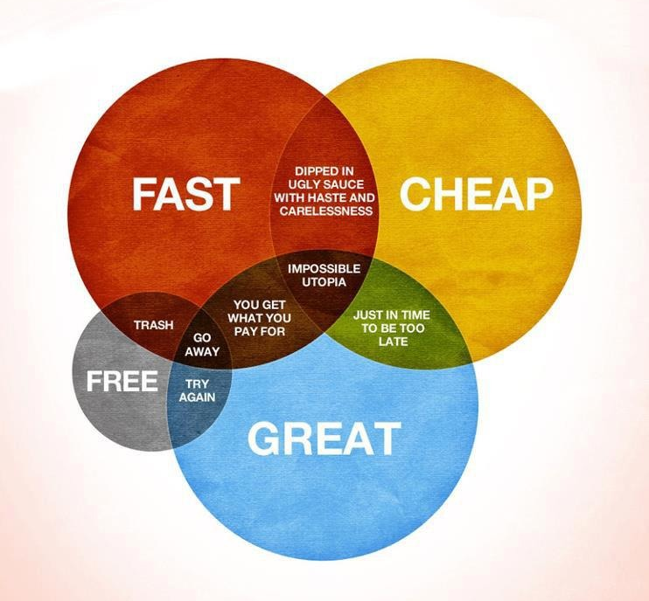
How would you like your prop built
You may only pick 2

